Slide 1
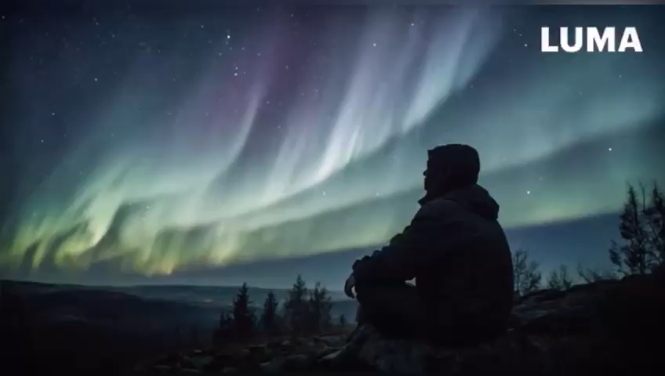
STELLAR STORIES
In this presentation, we will follow a solar flare character journeying from the sun to Earth, shedding light on the significant effects of space weather on power grids and various terrestrial systems. By exploring the intricate relationships between solar phenomena and our technology, we will gain insights into how solar activity can influence everything from satellite communications to electrical infrastructure.

Slide 2
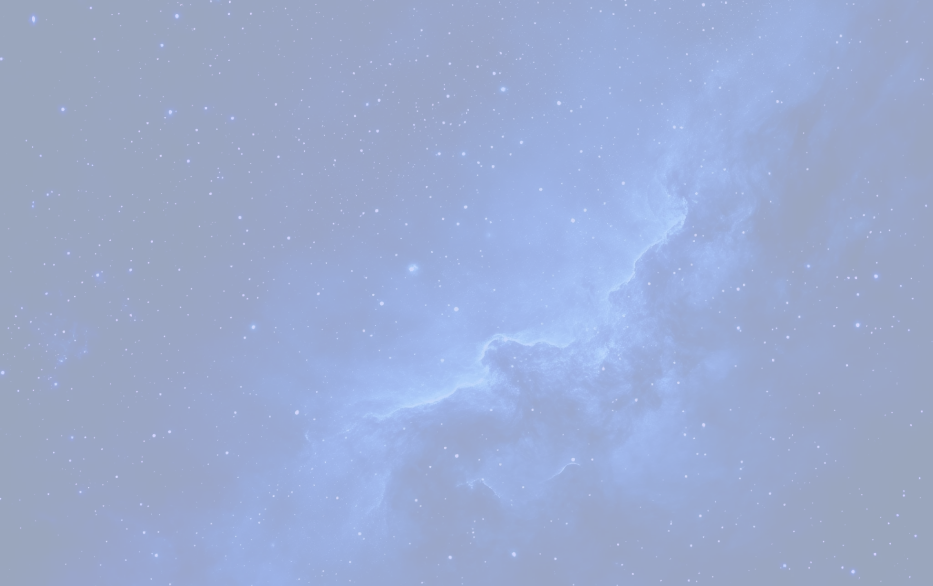




The Solar Flare Character
Introduction
Meet Flareon, our lively solar flare character, who brings energy and humor to serious topics about space weather impacts.
Origin Story
Flareon hails from the sun’s corona, where temperatures soar beyond a million degrees, generating bursts of radiant energy.
Character Traits
Flareon is vibrant and unpredictable, reflecting the nature of solar flares that can disrupt communication and power systems on Earth.

Slide 3
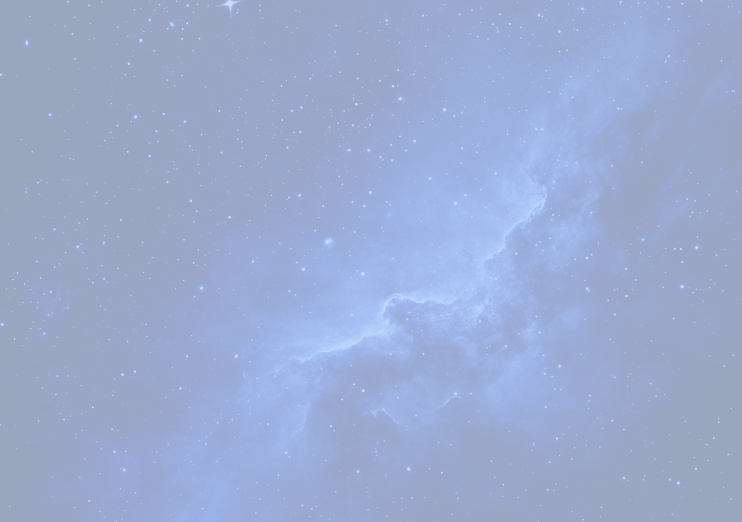
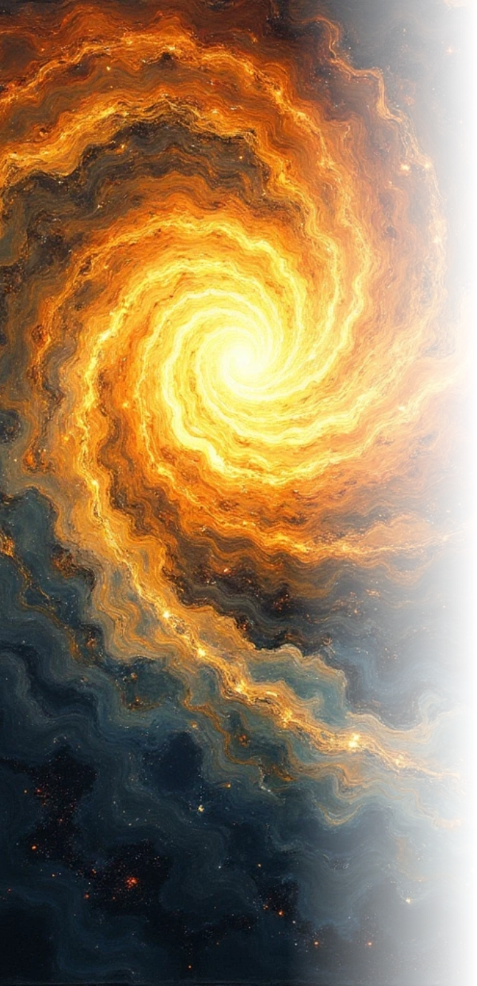

Understanding Space Weather
Definition
Space weather refers to the environmental conditions in space influenced by solar activities, such as solar flares and coronal mass ejections (CMEs).
Key Factors
Solar winds and magnetic storms are major components of space weather, affecting satellites, power grids, and even astronauts in orbit.
Impact on Technology
Understanding space weather is essential for mitigating risks to global navigation systems, radio communications, and electrical grid reliability.

Slide 4
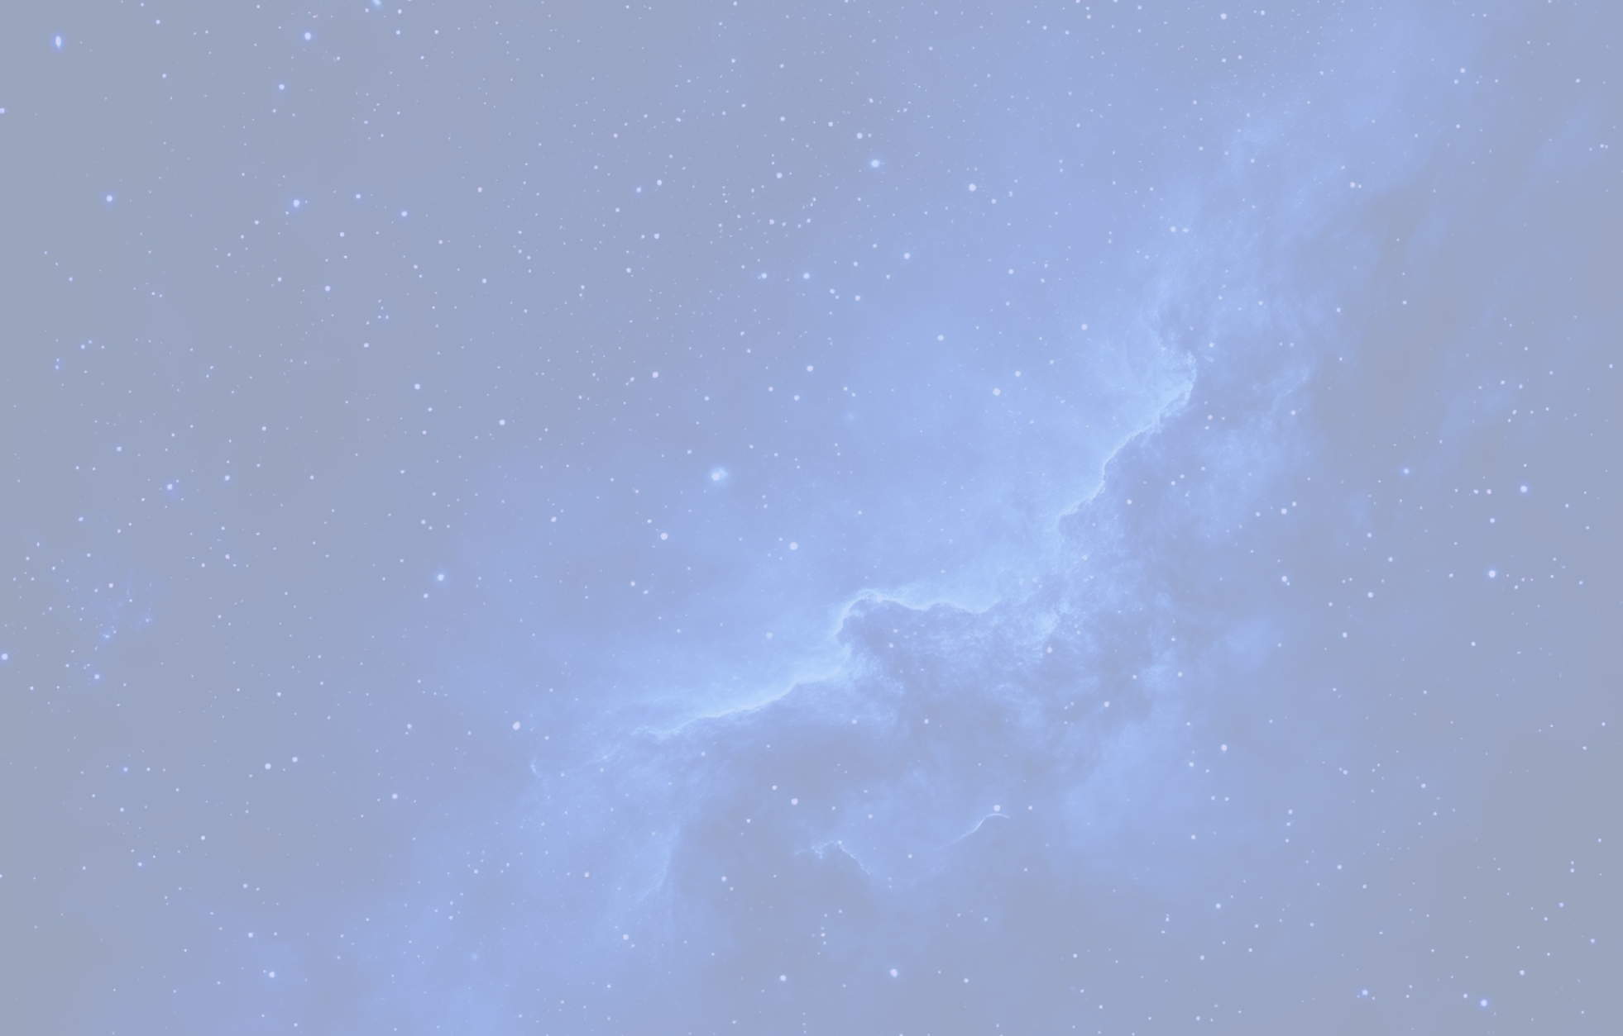
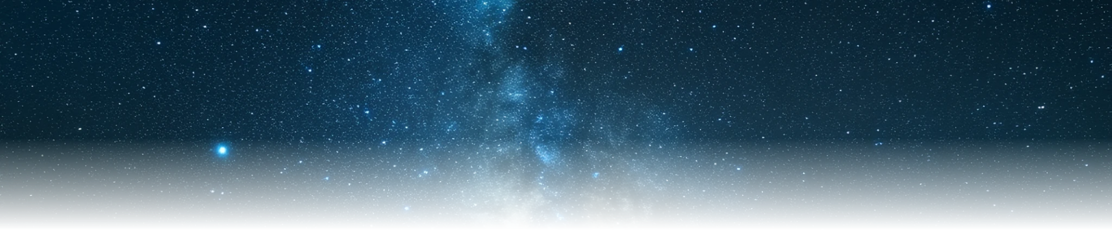
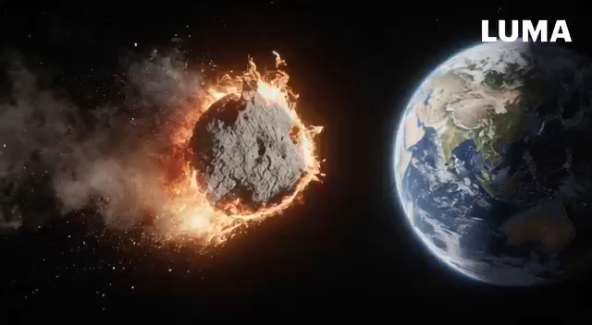



Effects of Solar Activity on Earth
Disruptions in GPS Functionality
Adjustments in Spacecraft Orbital Paths
Forecasting Operational Procedures
Farmers experience delays in planting caused by GPS disruptions.
Companies modify satellite trajectories to minimize atmospheric drag.
R2O2R improves research capabilities for more accurate forecasts.
1
2
3
4
5
Transition to Backup Equipment for Pilots
Research on Atmospheric Weather Patterns
Pilots depend on alternative systems because of radio malfunctions.
NASA investigates the effects of space weather on our planet.

Slide 5
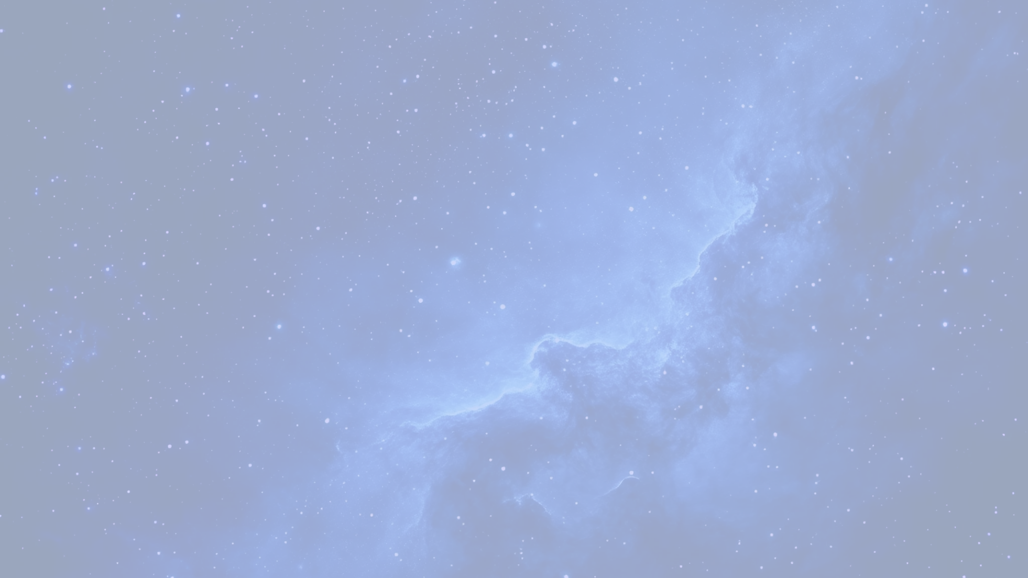
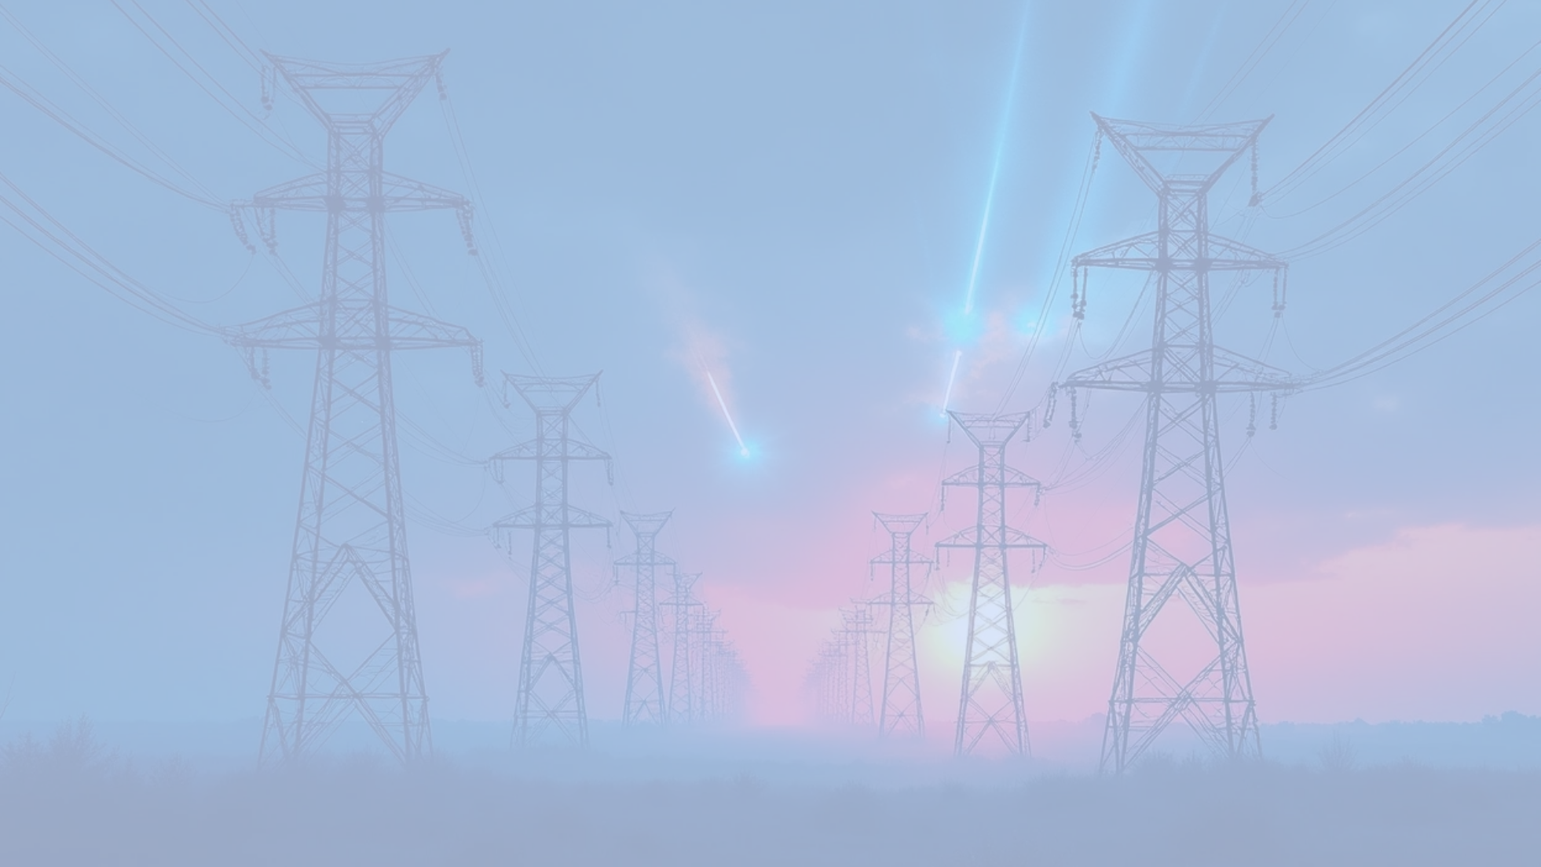
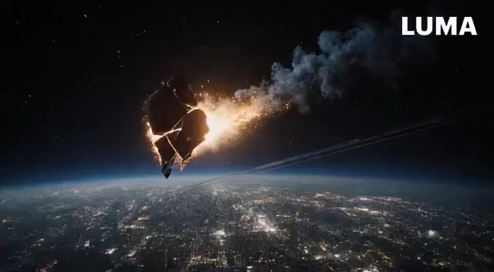



Effects on Power Grids:
Solar flares pose significant risks to power grids by inducing electromagnetic currents, leading to potential overload and failures. Historical incidents such as the Quebec blackout highlight the necessity of ongoing monitoring and preventive strategies by utility companies.
Electromagnetic Induction
Historical Events
Preventive Measures
The 1989 Quebec blackout, caused by a geomagnetic storm, illustrates the vulnerability of power infrastructures to space weather phenomena.
Utility companies now monitor space weather forecasts to prepare for potential disruptions and implement protective measures to safeguard the grid.
Solar flares can induce electric currents in power lines, potentially overloading systems and causing blackouts.

Slide 6



Prospective Areas for Future Research
Gathering Data
Techniques for Modeling
Collaboration Across Disciplines
It is essential to improve satellite and terrestrial observation systems to deepen our comprehension of space weather phenomena.
Creating advanced models to forecast space weather occurrences will aid in reducing the effects on technology and the broader community.
Involving specialists from diverse fields such as meteorology, engineering, and astrophysics to effectively tackle the challenges presented by space weather.
For more details and live preview, visit our project website: https://wardaafsheen.github.io/stellarstories/

Slide 7






Final Thoughts & Urgent Appeal
1
Being Informed is Crucial
Gaining knowledge of how solar activity affects technology can significantly improve our readiness.
2
Engagement
Get involved in observation initiatives to strengthen community defenses against the impacts of space weather.
3
Preparedness for Coming Challenges
As our technology advances, we must develop flexible approaches to manage unforeseen space weather conditions.

